Slide 1
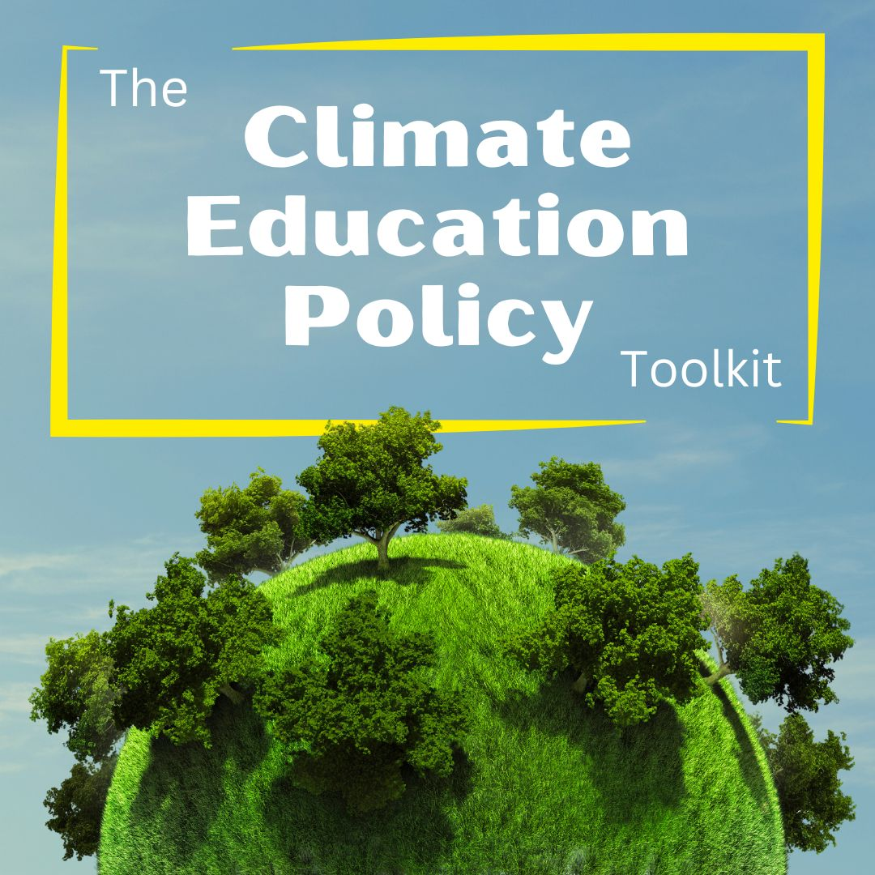
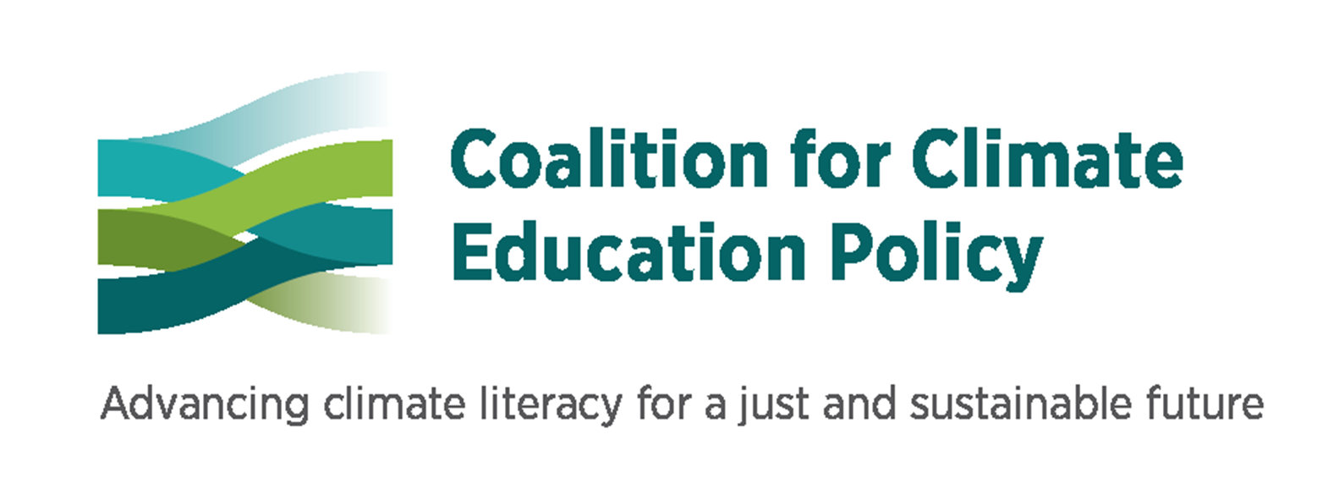

Designed with inclusivity and accessibility in mind, this toolkit is meant to support climate education advocacy at the community level.
Notes:
https://eepro.naaee.org/climate-education-policy-toolkit

Slide 2
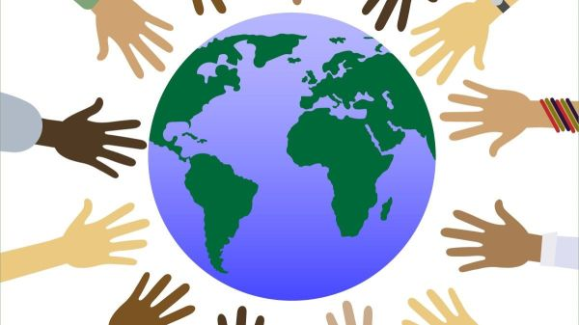
Whether you're a climate professional, legislator, educator, student, young adult, parent, or just a concerned individual, the resources within this Toolkit are designed to help you instigate change tailored to your specific political landscape.
Notes:
WHO is it for?

Slide 3
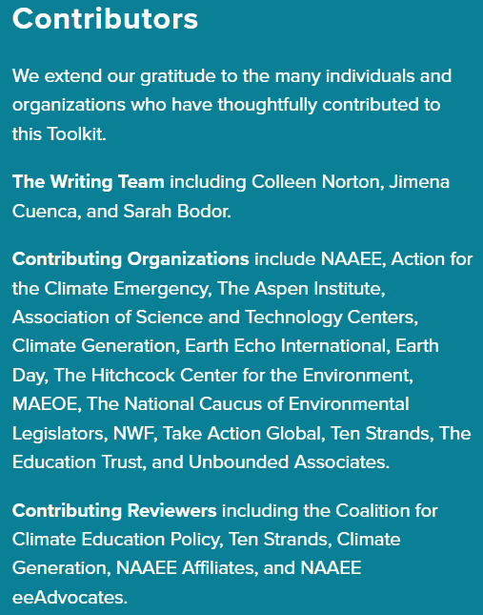
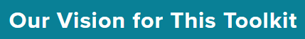
To ensure it’s accessible to everyone, regardless of background or location.
Notes:
WHO created it and WHY? Crowdsourced from members and organizations of the Coalition for Climate Education Policy, these resources have undergone rigorous evaluation to maintain high standards of quality and relevance.
https://eepro.naaee.org/climate-education-policy-toolkit/about

Slide 4
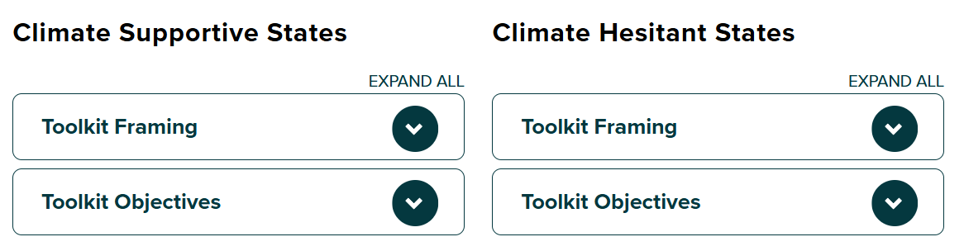
We recognize the diversity of climate conversations across the U.S. and understand that it’s more complex than a simple divide.
Notes:
WHAT exactly is it? WHAT will it do for my community? Our framing and objectives are designed to help individuals engage with climate action, no matter where their community’s conversation lies. You will find two versions of the framing and objectives because we want to ensure the toolkit can be adapted to various perspectives and contexts.
Share examples of differences in framing and objectives by clicking on the linked image.
https://dg56ycbvljkqr.cloudfront.net/sites/default/files/2024-09/Toolkit%20Framing%20and%20Objectives.pdf

Slide 5
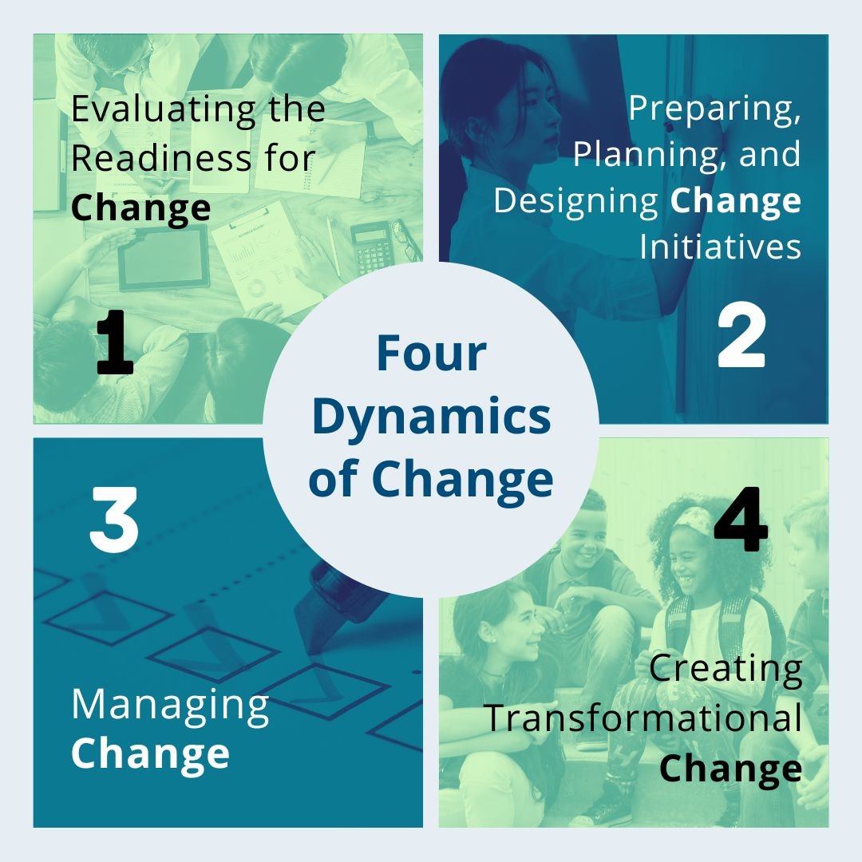
Step 1: Understanding Your Local Context
Notes:
HOW does it work? Change theories are useful when thinking about bringing impactful initiatives to a community. We offer 4 change theories to help you navigate and implement effective change. Start from the top, and work your way through the questions. It will be helpful to read through all questions, although some may not serve your specific needs and circumstances. Your answers to these questions will help you identify what is going well in your community and where your growing edges lie.
The questions in this document are organized in relation to four dynamics of change:
Evaluating the Readiness for Change
Preparing, Planning, and Designing Change Initiatives
Managing Change
Transformative Change
Share examples of guiding questions by clicking on the linked image.
https://eepro.naaee.org/climate-education-policy-toolkit/understanding-your-context

Slide 6
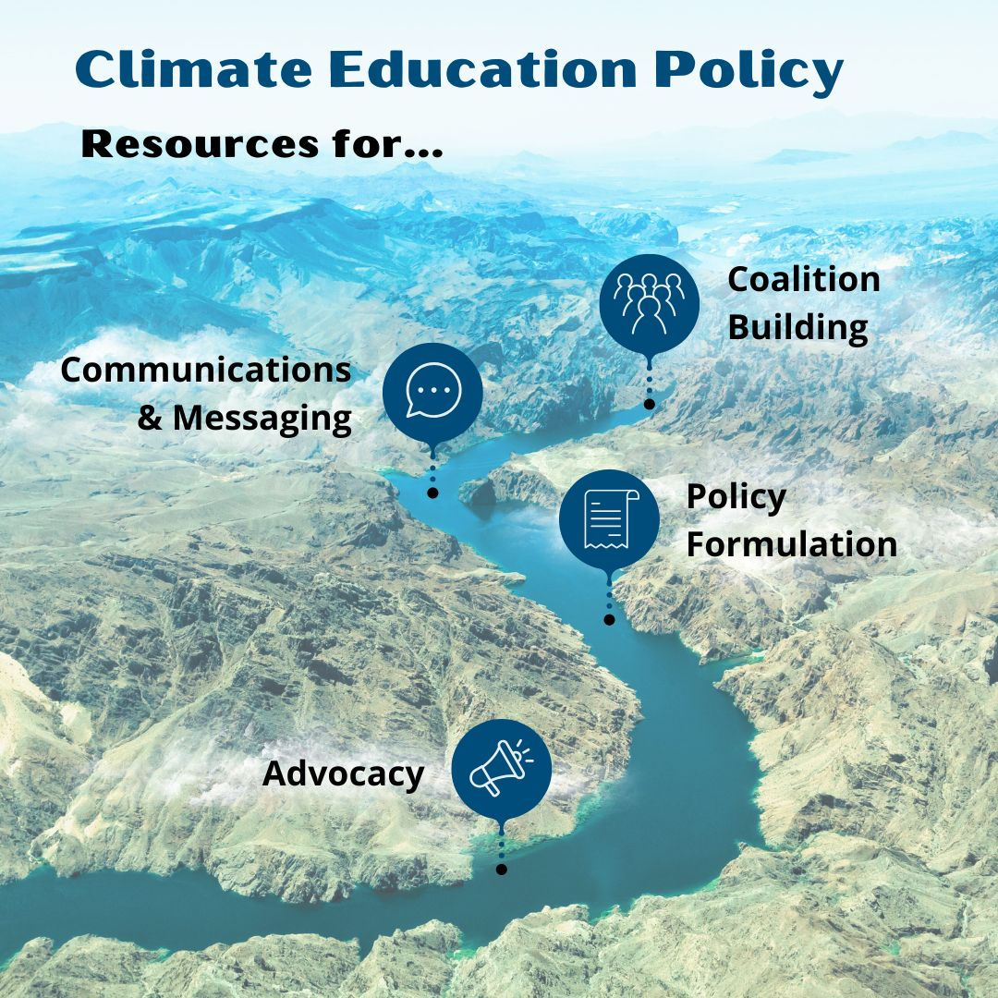
Step 2:
Find Your Resources
Notes:
Building upon your responses in Step 1 (Understanding Your Context), you now likely have a clearer understanding of your position within the policy planning and implementation phase. What are your successes? What are your growing edges? Check out our resource collections to help support you as you pursue your next steps.
Share examples of resources (one per content area) by clicking on the linked image. https://eepro.naaee.org/resource/making-case-climate-education-policy
Complete Resource Database: https://docs.google.com/spreadsheets/d/1lbRwxoFGWkWsgz6xb7iIMGj4e9ufy-OKJ2VIVWDn4NI/edit?usp=sharing

Slide 7
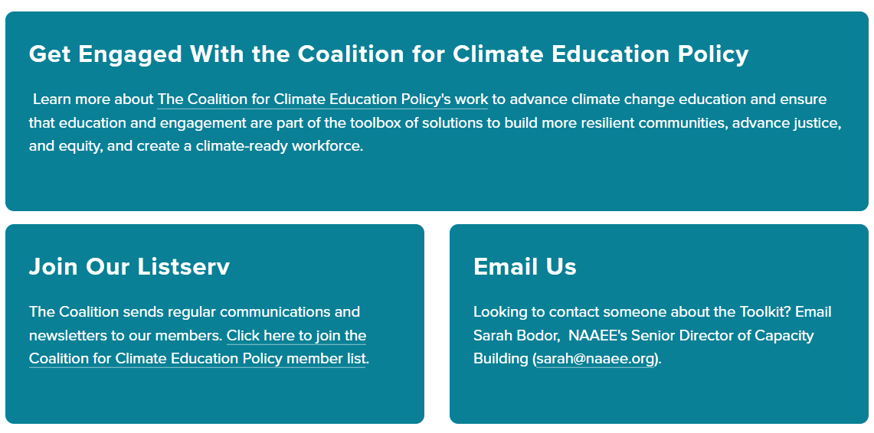
Notes:
Join us! Do you have suggestions for new resources to add? Have you implemented an effective climate education policy or have a success story to share?
We’d love to hear from you! Please share your ideas, experiences, and feedback using our survey link: https://docs.google.com/forms/d/e/1FAIpQLSd8qn9nOSV8_uqjrQ7RKA1sjAYP4I37rueKvct0e18ozLB0UQ/viewform.
Your input can help us enhance our toolkit and inspire others in the community.
https://eepro.naaee.org/climate-education-policy-toolkit/faqs-contact

Slide 8

Thank You!

